Slide 1
Personal Finance Management App

Slide 2
Introduction to Personal Finance Management
Title: Why Personal Finance Management Matters
Content:
Briefly explain the importance of managing personal finances.
Discuss challenges people face with budgeting, saving, investing, and tracking expenses.
Introduce the Personal Finance Management App as the solution to these challenges.

Slide 3
Key Features of the App
Title: Key Features Overview
Content:
Budget Tracking
Expense Categorization
Expense Insights & Reports
Bill Reminders & Alerts
Goal Setting & Savings Planner
Debt Tracking & Management
Investment Monitoring
Multi-Account Integration
Security & Privacy
Financial Education & Tips

Slide 4
Budget Tracking
Title: Budget Tracking
Content:
Ability to create custom budgets for different categories (e.g., groceries, rent, entertainment).
Set monthly or weekly spending limits.
Real-time tracking of budget vs actual spending.
Expense Categorization
Title: Expense Categorization
Content:
Automatically categorizes transactions (e.g., food, transport, utilities).
Visual representation of expenses through charts and graphs.
Helps users identify spending patterns and areas for improvement.

Slide 5
Goal Setting & Savings Planner
Title: Goal Setting & Savings Planner
Content:
Set short-term and long-term financial goals (e.g., saving for a vacation, retirement).
Track progress and make adjustments to reach goals faster.
Visualize goals through progress bars or graphs.
Security & Privacy
Title: Security & Privacy
Content:
High-level encryption and multi-factor authentication (MFA) to protect user data.
Privacy controls to ensure that personal financial data remains confidential.
Commitment to maintaining secure and trustworthy service.

Slide 6
Benefits of the App
Title: Why Choose the Personal Finance Management App?
Content:
Stay organized and in control of your finances.
Improve savings habits and track financial goals.
Eliminate late fees and avoid unnecessary debt.
Gain insights into spending behavior for smarter financial decisions.
Pricing Plans (If Applicable)
Title: Pricing & Subscription Plans
Content:
Offer details about free trials, premium features, or subscription pricing (if applicable).
Highlight the value users receive for their investment.

Slide 7
Activity main.xml
This XML file does not appear to have any style information associated with it. The document tree is shown below.
<manifest xmlns:android="http://schemas.android.com/apk/res/android" android:compileSdkVersion="28" android:compileSdkVersionCodename="9" package="com.tototomato.financialmanagement" platformBuildVersionCode="28" platformBuildVersionName="9">
<supports-screens android:anyDensity="true" android:largeScreens="true" android:normalScreens="true" android:smallScreens="true" android:xlargeScreens="true"/>
<uses-permission android:name="android.permission.INTERNET"/>
<uses-permission android:name="android.permission.WRITE_EXTERNAL_STORAGE"/>
<uses-permission android:name="android.permission.USE_FINGERPRINT"/>
<uses-feature android:name="android.hardware.screen.portrait" android:required="false"/>
<uses-feature android:name="android.hardware.screen.landscape" android:required="false"/>

Slide 8
<uses-permission android:name="android.permission.ACCESS_NETWORK_STATE"/>
<uses-permission android:name="android.permission.WAKE_LOCK"/>
<uses-feature android:glEsVersion="0x00020000" android:required="true"/>
<uses-permission android:name="com.google.android.finsky.permission.BIND_GET_INSTALL_REFERRER_SERVICE"/>
<uses-permission android:name="com.google.android.c2dm.permission.RECEIVE"/>
<application android:allowBackup="false" android:appComponentFactory="android.support.v4.app.CoreComponentFactory" android:hardwareAccelerated="true" android:icon="@drawable/icon" android:label="@string/app_name" android:name="com.seattleclouds.App" android:supportsRtl="true" android:theme="@style/DefaultAppTheme" android:usesCleartextTraffic="true">
<activity android:name="com.seattleclouds.AppStarterActivity" android:theme="@style/DefaultAppTheme" android:windowSoftInputMode="stateAlwaysHidden">
<intent-filter>
<action android:name="android.intent.action.MAIN"/>
<category android:name="android.intent.category.LAUNCHER"/>
</intent-filter>
<meta-data android:name="android.app.default_searchable" android:value="none"/>
</activity>

Slide 9
<uses-library android:name="org.apache.http.legacy" android:required="false"/>
<meta-data android:name="com.google.android.maps.v2.API_KEY" android:value="@string/google_maps_v2_api_key"/>
<meta-data android:name="com.facebook.sdk.ApplicationId" android:value="@string/facebook_app_id"/>
<meta-data android:name="PyzeAppKey" android:value="@string/pyze_app_key"/>
<meta-data android:name="firebase_analytics_collection_deactivated" android:value="@bool/firebase_analytics_collection_deactivated"/>
<meta-data android:name="firebase_messaging_auto_init_enabled" android:value="true"/>
<activity android:name="com.seattleclouds.PageStarterActivity"/>
<activity android:name="com.seattleclouds.TabsAppActivity" android:windowSoftInputMode="adjustResize"/>
<activity android:name="com.seattleclouds.SimpleAppActivity" android:windowSoftInputMode="adjustResize"/>
<activity android:name="com.seattleclouds.SCTabsAppActivity" android:windowSoftInputMode="adjustResize"/>
<activity android:name="com.seattleclouds.ActionBarTabsAppActivity" android:windowSoftInputMode="adjustResize"/>
<activity android:label="@string/settings_title" android:name="com.seattleclouds.SettingsActivity"/>
<activity android:name="com.seattleclouds.previewer.PreviewerActivity" android:theme="@style/DefaultAppTheme" android:windowSoftInputMode="adjustPan|stateHidden">
<meta-data android:name="android.app.default_searchable" android:value="none"/>
</activity>

Slide 10
<activity android:name="com.seattleclouds.previewer.appmart.PreviewerAppMartActivity" android:theme="@style/DefaultAppTheme" android:windowSoftInputMode="adjustResize">
<meta-data android:name="android.app.default_searchable" android:value="none"/>
</activity>
<activity android:name="com.seattleclouds.previewer.appmart.PreviewerAppMartTemplatesActivity"
android:theme="@style/DefaultAppTheme"/>
<activity android:name="com.seattleclouds.previewer.appmart.order.OrderDetailActivity" android:theme="@style/DefaultAppTheme"/>
<activity android:name="com.seattleclouds.previewer.PreviewerAboutActivity" android:theme="@style/DefaultAppTheme"/>
<activity android:label="" android:name="com.seattleclouds.previewer.PreviewerOneFragmentActivity" android:theme="@style/DefaultAppTheme"/>
<activity android:name="com.seattleclouds.previewer.PreviewerTemplatesActivity" android:theme="@style/DefaultAppTheme"/>
<activity android:name="com.seattleclouds.previewer.PreviewerAnnouncementActivity" android:theme="@style/DefaultAppTheme"/>
<activity android:label="" android:name="com.seattleclouds.SCPageFragmentActivity" android:windowSoftInputMode="adjustResize"/>
<activity android:label="" android:name="com.seattleclouds.modules.locationlock.AutoFinishPageFragmentActivity"/>
<activity android:exported="false" android:label="" android:launchMode="singleTop"

Slide 11
android:name="com.seattleclouds.location.LocationDetectorActivity">
<intent-filter>
<action android:name="android.intent.action.SEARCH"/>
</intent-filter>
<meta-data android:name="android.app.searchable" android:resource="@xml/location_searchable"/>
</activity>
<activity android:label="" android:name="com.seattleclouds.modules.calendar.EventEditActivity"/>
<activity android:exported="true" android:launchMode="singleTop" android:name="com.seattleclouds.modules.search.SearchActivity" android:windowSoftInputMode="adjustResize">
<intent-filter>
<action android:name="android.intent.action.SEARCH"/>
</intent-filter>
<meta-data android:name="android.app.searchable" android:resource="@xml/content_searchable"/>
</activity>
<activity android:label="" android:name="com.seattleclouds.modules.savephoto.SavePhotoActivity"/>
<activity android:label="" android:name="com.seattleclouds.EmptyActivity"/>
<activity android:label="" android:name="com.seattleclouds.OneFragmentActivity"/>
<activity android:label="" android:name="com.seattleclouds.modules.voicerecord.VoiceRecordPickerActivity" android:screenOrientation="portrait"/>
<activity android:label="" android:name="com.seattleclouds.modules.signaturestamp.DrawSurfaceActivity"/>
<activity android:label="" android:name="com.seattleclouds.gcm.AnnouncementActivity"/>

Slide 12
<activity android:exported="true" android:name="com.seattleclouds.paypal.PayPalMessage" android:theme="@style/DefaultAppTheme.Dialog">
<intent-filter>
<data android:scheme="advmillion.neesa.financialmanagement"/>
<action android:name="android.intent.action.VIEW"/>
<category android:name="android.intent.category.DEFAULT"/>
<category android:name="android.intent.category.BROWSABLE"/>
</intent-filter>
</activity>
<activity android:exported="true" android:name="me.dm7.barcodescanner.zxing.ZXingScanner" android:windowSoftInputMode="stateAlwaysHidden">
<intent-filter>
<action android:name="com.google.zxing.client.android.SCAN.DISABLED"/>
<category android:name="android.intent.category.DEFAULT"/>
</intent-filter>
</activity>
<activity android:name="com.seattleclouds.modules.order.indiapay.IndiaPayActivity" android:theme="@style/DefaultAppTheme"/>
<activity android:label="" android:name="com.seattleclouds.modules.phonegap.PhoneGapActivity"/>
<activity android:label="" android:name="com.seattleclouds.modules.cameracover.CameraCoverActivity" android:theme="@style/DefaultAppTheme"/>

Slide 13
<activity android:label="" android:name="com.seattleclouds.modules.rateandreview.NewRateAndCommentActivity"/>
<activity android:name="com.seattleclouds.modules.order.OrderPaypalActivity"/>
<activity android:name="com.seattleclouds.startupoptions.AgreementActivity"/>
<activity android:name="com.seattleclouds.startupoptions.WelcomeActivity"/>
<activity android:name="com.seattleclouds.modules.pollpage.ResultsActivity"/>
<activity android:excludeFromRecents="true" android:launchMode="singleTask" android:name="com.seattleclouds.modules.podcast.player.AudioPlayerActivity" android:taskAffinity=""/>
<activity android:excludeFromRecents="true" android:launchMode="singleTask" android:name="com.seattleclouds.modules.podcast.download.PodcastDownloadsActivity" android:taskAffinity=""/>
<activity android:label="@string/app_auth_title_sign_in" android:name="com.seattleclouds.appauth.AppAuthRegisterActivity"/>
<service android:exported="false" android:name="com.seattleclouds.modules.podcast.player.PodcastPlayerService">
<intent-filter>
<action android:name="com.tototomato.financialmanagement.modules.podcast.player.ACTION_TOGGLE_PLAY"/>
<action android:name="com.tototomato.financialmanagement.modules.podcast.player.ACTION_PLAY"/>
<action android:name="com.tototomato.financialmanagement.modules.podcast.player.ACTION_PAUSE"/>

Slide 14
<action android:name="com.tototomato.financialmanagement.modules.podcast.player.ACTION_STOP"/>
<action android:name="com.tototomato.financialmanagement.modules.podcast.player.ACTION_SET_URL"/>
<action android:name="com.tototomato.financialmanagement.modules.podcast.player.ACTION_REWIND"/>
<action android:name="com.tototomato.financialmanagement.modules.podcast.player.ACTION_FAST_FORWARD"/>
</intent-filter>
</service>
<service android:exported="false" android:name="com.seattleclouds.modules.podcast.download.PodcastDownloadService">
<intent-filter>
<action android:name="com.tototomato.financialmanagement.modules.podcast.download.ACTION_STOP_DOWNLOADS"/>
</intent-filter>
</service>
<provider android:authorities="com.tototomato.financialmanagement.FileProvider" android:exported="false" android:grantUriPermissions="true" android:name="android.support.v4.content.FileProvider">
<meta-data android:name="android.support.FILE_PROVIDER_PATHS" android:resource="@xml/provider_paths"/>

Slide 15
</provider>
<receiver android:name="com.seattleclouds.modules.goaltracker.GoalTrackerAlarmReceiver"/>
<receiver android:enabled="false" android:name="com.seattleclouds.location.LocationProvidersChangedBroadcastReceiver">
<intent-filter>
<action android:name="android.location.PROVIDERS_CHANGED"/>
</intent-filter>
</receiver>
<activity android:configChanges="keyboardHidden|orientation|screenSize" android:name="com.revmob.FullscreenActivity" android:theme="@android:style/Theme.Translucent"/>
<activity android:configChanges="keyboard|keyboardHidden|orientation|screenLayout|screenSize" android:label="@string/app_name" android:name="com.facebook.FacebookActivity" android:theme="@style/com_facebook_activity_theme"/>
<activity android:exported="true" android:name="com.facebook.CustomTabActivity">
<intent-filter>
<action android:name="android.intent.action.VIEW"/>
<category android:name="android.intent.category.DEFAULT"/>
<category android:name="android.intent.category.BROWSABLE"/>
<data android:scheme="@string/fb_login_protocol_scheme"/>
</intent-filter>
</activity>
<receiver android:enabled="true" android:exported="false" android:name="com.seattleclouds.scm.PushManagerReceiver"/>
<receiver android:exported="false"

Slide 16
android:name="com.seattleclouds.location.geofencing.ReceiveTransitionBroadcastReceiver">
<intent-filter>
<action android:name="com.tototomato.financialmanagement.location.action.PROCESS_UPDATES"/>
</intent-filter>
</receiver>
<activity android:name="com.seattleclouds.modules.loginregister.LoginRegisterEditProfile" android:windowSoftInputMode="adjustResize"/>
<activity android:label="@string/app_name" android:name="com.seattleclouds.SCNavigationDrawerAppActivity"/>
<activity android:name="com.seattleclouds.ads.RemoveAdsActivity" android:theme="@android:style/Theme.Translucent"/>
<activity android:excludeFromRecents="true" android:exported="false" android:name="com.google.android.gms.auth.api.signin.internal.SignInHubActivity" android:theme="@android:style/Theme.Translucent.NoTitleBar"/>
<service android:exported="true"
android:name="com.google.android.gms.auth.api.signin.RevocationBoundService" android:permission="com.google.android.gms.auth.api.signin.permission.REVOCATION_NOTIFICATION"/>
<receiver android:enabled="true" android:exported="false" android:name="com.google.android.gms.analytics.AnalyticsReceiver"/>
<service android:enabled="true" android:exported="false" android:name="com.google.android.gms.analytics.AnalyticsService"/>
<service android:enabled="true" android:exported="false" android:name="com.google.android.gms.analytics.AnalyticsJobService" android:permission="android.permission.BIND_JOB_SERVICE"/>

Slide 17
android:permission="android.permission.BIND_JOB_SERVICE"/>
<service android:exported="true" android:name="com.google.firebase.messaging.FirebaseMessagingService">
<intent-filter android:priority="-500">
<action android:name="com.google.firebase.MESSAGING_EVENT"/>
</intent-filter>
</service>
<service android:exported="false" android:name="com.google.firebase.components.ComponentDiscoveryService">
<meta-data android:name="com.google.firebase.components:com.google.firebase.analytics.connector.internal.AnalyticsConnectorRegistrar" android:value="com.google.firebase.components.ComponentRegistrar"/>
<meta-data android:name="com.google.firebase.components:com.google.firebase.iid.Registrar" android:value="com.google.firebase.components.ComponentRegistrar"/>
</service>
<receiver android:enabled="true" android:exported="false" android:name="com.google.android.gms.measurement.AppMeasurementReceiver"/>
<receiver android:enabled="true" android:exported="true" android:name="com.google.android.gms.measurement.AppMeasurementInstallReferrerReceiver" android:permission="android.permission.INSTALL_PACKAGES">
<intent-filter>
<action android:name="com.android.vending.INSTALL_REFERRER"/>
</intent-filter>
</receiver>

Slide 18
<service android:enabled="true" android:exported="false" android:name="com.google.android.gms.measurement.AppMeasurementService"/>
<service android:enabled="true" android:exported="false" android:name="com.google.android.gms.measurement.AppMeasurementJobService" android:permission="android.permission.BIND_JOB_SERVICE"/>
<receiver android:exported="true" android:name="com.google.firebase.iid.FirebaseInstanceIdReceiver" android:permission="com.google.android.c2dm.permission.SEND">
<intent-filter>
<action android:name="com.google.android.c2dm.intent.RECEIVE"/>
</intent-filter>
</receiver>
<service android:exported="true" android:name="com.google.firebase.iid.FirebaseInstanceIdService">
<intent-filter android:priority="-500">
<action android:name="com.google.firebase.INSTANCE_ID_EVENT"/>
</intent-filter>
</service>
<activity android:exported="false" android:name="com.google.android.gms.common.api.GoogleApiActivity" android:theme="@android:style/Theme.Translucent.NoTitleBar"/>
<activity android:configChanges="keyboardHidden|orientation|screenSize" android:name="com.facebook.ads.AudienceNetworkActivity"/>
<provider android:authorities="com.tototomato.financialmanagement.firebaseinitprovider" android:exported="false" android:initOrder="100" android:name="com.google.firebase.provider.FirebaseInitProvider"/>
<activity

Slide 19
android:configChanges="keyboard|keyboardHidden|orientation|screenLayout|screenSize|smallestScreenSize|uiMode" android:exported="false" android:name="com.google.android.gms.ads.AdActivity" android:theme="@android:style/Theme.Translucent"/>
<meta-data android:name="com.google.android.gms.version" android:value="@integer/google_play_services_version"/>
<activity android:name="com.facebook.CustomTabMainActivity"/>
<provider android:authorities="com.tototomato.financialmanagement.FacebookInitProvider" android:exported="false" android:name="com.facebook.internal.FacebookInitProvider"/>
<receiver android:exported="false" android:name="com.facebook.CurrentAccessTokenExpirationBroadcastReceiver">
<intent-filter>
<action android:name="com.facebook.sdk.ACTION_CURRENT_ACCESS_TOKEN_CHANGED"/>
</intent-filter>
</receiver>
<receiver android:exported="true" android:name="com.facebook.CampaignTrackingReceiver" android:permission="android.permission.INSTALL_PACKAGES">
<intent-filter>
<action android:name="com.android.vending.INSTALL_REFERRER"/>
</intent-filter>
</receiver>
</application>
</manifest>

Slide 20
App.xml
<xml>
<navigation type="tabs" backgroundColor="" backgroundImage="" contentOverlap="" itemsPosition="" textStyle="" textSize="" textFont="" iosStyleNavigation="">
<items>
<item icon="" text="Home" textColor="" selectedTextColor="" selectedIcon="" backgroundImage="" selectedBackgroundImage="" backgroundColor="" selectedBackgroundColor="" />
<item icon="" text="Menu" textColor="" selectedTextColor="" selectedIcon="" backgroundImage="" selectedBackgroundImage="" backgroundColor="" selectedBackgroundColor="" />
<item icon="" text="Calculator" textColor="" selectedTextColor="" selectedIcon="" backgroundImage="" selectedBackgroundImage="" backgroundColor="" selectedBackgroundColor="" />
<item icon="" text="Share" textColor="" selectedTextColor="" selectedIcon="" backgroundImage="" selectedBackgroundImage="" backgroundColor="" selectedBackgroundColor="" />
</items>
</navigation>
<targetplatform simulator="Nexus5">Android</targetplatform>
<template price="199.99" id="SpaceApp" scaleWebPagesToBaseResolution="true" isUniversalApp="false" topadtype="none" bottomadtype="admob" globalLogo="" />
<prop id="appname" title="App Name">FinancialManagement</prop>

Slide 21
<prop id="tab1text" title="Tab1 Text">tab1</prop>
<prop id="tab1icon" title="Tab1 Icon">cover.png</prop>
<prop id="tab2text" title="Tab2 Text">tab2</prop>
<prop id="tab2icon" title="Tab2 Icon">index.png</prop>
<prop id="tab3text" title="Tab3 Text">tab3</prop>
<prop id="tab3icon" title="Tab3 Icon">content.png</prop>
<prop id="tab4text" title="Tab4 Text">tab4</prop>
<prop id="tab4icon" title="Tab4 Icon">coffee.png</prop>
<planname>Basic</planname>
<file id="appStyles.xml" newsfile="yes">
</file>
<page id="tab1.html" type="html" transition="" slidepageid="none" slidetransition="" hasreviews="no" hassend="no" hasfields="no" topad="no" bottomad="no" topadtype="none" bottomadtype="admob" dynamicdata="false" jsonurl="" hasreviewhtmlkey="no" kind="html" title="" logo="" shownavbar="yes" zoomEnabled="false" loadWebUrlsInSameWebView="false" backgroundColor="" />
<page id="tab3.html" type="calc" kind="html" transition="" slidepageid="none"
slidetransition="" hasreviews="no" hassend="no" hasfields="no" topadtype="none" bottomadtype="admob" dynamicdata="false" jsonurl="" hidebottombaratpush="no" hasreviewhtmlkey="no" title="" logo="" shownavbar="yes" zoomEnabled="false" loadWebUrlsInSameWebView="false" backgroundColor="">
</page>
<page id="tab2.html" type="html" transition="" slidepageid="none" slidetransition="" hasreviews="no" hassend="no" hasfields="no" topad="no" bottomad="no" topadtype="none" bottomadtype="admob" dynamicdata="false" jsonurl="" hasreviewhtmlkey="no" kind="html" title="" logo="" shownavbar="yes"

Slide 22
zoomEnabled="false" loadWebUrlsInSameWebView="false" backgroundColor="" />
<page id="tab4.html" type="appshare" kind="html" transition="" slidepageid="none" slidetransition="" hasreviews="no" hassend="no" hasfields="false" topadtype="none" bottomadtype="admob" dynamicdata="false" jsonurl="" hidebottombaratpush="no" hasreviewhtmlkey="no" fbappid="" title="" logo="" shownavbar="yes" zoomEnabled="false" loadWebUrlsInSameWebView="false" backgroundColor="">
<appdescription>This app contains financial management handbook and guidelines. Download for free now!</appdescription>
<links>
<share_link>http://build.appsmillion.com/marketr.aspx?p=%2BFBV3DSpqP7eM%2FP5WldEbu30jYH%2F9F6OYCHbv6uKDX1ImjhqvyOX6MwK2hAy6VCJ</share_link>
<primarystore>https://play.google.com/store/apps/details?id=com.tototomato.financialmanagement</primarystore>
<iphone>
</iphone>
<ipad>
</ipad>
<android>https://play.google.com/store/apps/details?id=com.tototomato.financialmanagement</android>
<kindle>
</kindle>
</links>
</page>

Slide 23
<restrictedaccess>
<feature id="announcements" enabled="true" />
<feature id="calendar" enabled="true" />
<feature id="coupon" enabled="true" />
<feature id="geofences" enabled="true" />
<feature id="loyalty" enabled="true" />
<feature id="map" enabled="true" />
<feature id="productorder" enabled="true" />
<feature id="pushnotifications" enabled="true" />
<feature id="Booking" enabled="true" />
<feature id="pnTopicSubscription" enabled="true" />
<feature id="loginregister" enabled="true" />
</restrictedaccess>
<rateapp appleid="" rateatlaunch="no" rateatrelaunch="no" message="" cancelmessage="" remindmessage="" actionmessage="" />
<ads allowUsingAdvertisingId="false" />
<admobpublisher id="ca-app-pub-2715744860432773/1419791442" interstitialUnitId="ca-app-pub-2715744860432773/2174825134" />
<doubleclickpublisher unitId="" />
<pollfish apiKey="" padding="0" position="na" />
<revmobappid id="-" />
<airpush appId="" apiKey="" interstitialAdType="" />
<scads refreshRate="30" />
<googleanalyticsid id="" />

Slide 24
<localizablelanguage value="en" />
<paypalappid id="" />
<fbapp apikey="392048634524604" />
<androidAppLicensing enabled="false" publicKey="" />
<apkExpansionFiles enabled="false" />
<androidInAppBilling enabled="false" />
<android installLocation="auto" />
<pdftron licenseKey="" />
<webView bouncesEnabled="false" hideLoadingAnimation="false" externalSiteZoomEnabled="true" />
<sharepointclient url="" username="" password="" />
<appstorelink>
</appstorelink>
<googleMaps androidApiV2Key="" />
<baiduMaps baiduMapsApiKeyAndroid="" baiduMapsApiKeyiOS="" />
<webapp statusBarStyle="default" iconsStyle="precomposed" offlineModeEnabled="false" inAppLinks="false" />
<locationServices>
<inUseDescription>
</inUseDescription>
<alwaysDescription> </locationServices>
<inAppSettings />
<hostedresources>
</hostedresources>

Slide 25
<file id="effective_time_management_importantvsurgent.html" newsfile="yes" />
<file id="time_management_introduction.html" newsfile="yes" />
<file id="12_steps_time_management.html" newsfile="yes" />
<file id="10_strategies_to_time_management.html" newsfile="yes" />
<file id="Introduction_to_Financial_Management.html" newsfile="no" />
<page id="Introduction_to_Financial_Management.html" type="pdfreader" kind="native" transition="NONE" slidepageid="none" slidetransition="" hasreviews="no" hassend="no" hasfields="no" topadtype="inherited" bottomadtype="inherited" dynamicdata="false" jsonurl="" hidebottombaratpush="no" hasreviewhtmlkey="no" textDirection="ltr" title="" logo="" shownavbar="yes" interstitialadtype="admob" interstitialadview="fullscreen">
<pdffile>1-Introduction_to_Financial_Management.pdf</pdffile>
</page>
<page id="Financial_Management_An_Overview.html" type="pdfreader" kind="native" transition="NONE" slidepageid="none" slidetransition="" hasreviews="no" hassend="no" hasfields="no" topadtype="inherited" bottomadtype="inherited" dynamicdata="false" jsonurl="" hidebottombaratpush="no" hasreviewhtmlkey="no" textDirection="ltr" title="" logo="" shownavbar="yes" interstitialadtype="admob" interstitialadview="fullscreen">
<pdffile>2-Financial_Management_an_Overview.pdf</pdffile>
</page>
<page id="Financial_Management_Handbook.html" type="pdfreader" kind="native" transition="NONE" slidepageid="none" slidetransition="" hasreviews="no" hassend="no" hasfields="no" topadtype="inherited" bottomadtype="inherited" dynamicdata="false"

Slide 26
jsonurl="" hidebottombaratpush="no" hasreviewhtmlkey="no" textDirection="ltr" title="" logo="" shownavbar="yes" interstitialadtype="admob" interstitialadview="fullscreen">
<pdffile>3-Financial_management_handbook.pdf</pdffile>
</page>
<page id="Financial_Management_Guidelines.html" type="pdfreader" kind="native" transition="NONE" slidepageid="none" slidetransition="" hasreviews="no" hassend="no" hasfields="no" topadtype="inherited" bottomadtype="inherited" dynamicdata="false" jsonurl="" hidebottombaratpush="no" hasreviewhtmlkey="no" textDirection="ltr" title="" logo="" shownavbar="yes" interstitialadtype="admob" interstitialadview="fullscreen">
<pdffile>4-guidelines-financial-management.pdf</pdffile>
</page>
<rotationapp>true</rotationapp>
<androidC2DM enabled="false" altEnabled="false" />
<androidpermissions>
<permission name="android.permission.INTERNET" enabled="true" />
<permission name="android.permission.ACCESS_COARSE_LOCATION" enabled="false" />
<permission name="android.permission.ACCESS_FINE_LOCATION" enabled="false" />
<permission name="android.permission.WRITE_EXTERNAL_STORAGE" enabled="true" />
<permission name="android.permission.ACCESS_NETWORK_STATE" enabled="false" />
<permission name="android.permission.READ_PHONE_STATE" enabled="false" />
<permission name="android.permission.RECORD_AUDIO" enabled="false" />
<permission name="android.permission.CAMERA" enabled="false" />

Slide 27
</androidpermissions>
<androidversion>1.5</androidversion>
<androidversioncode>6</androidversioncode>
<androidbundlename>com.tototomato.financialmanagement</androidbundlename>
<androidshortappname>FinancialManagement</androidshortappname>
<syncenabled>true</syncenabled>
<file id="tab3.html" newsfile="no" />
<file id="tab4.html" newsfile="no" />
<file id="tab2.html" newsfile="no" />
<file id="tab1.html" newsfile="no" />
<dropboxapp dropboxapikey="" />
<healthKitServices>
<healthShareUsage>
</healthShareUsage>
<healthUpdateUsage>
</healthUpdateUsage>
</healthKitServices>
<cameraServices>
<cameraUsageDescription>
</cameraUsageDescription>
</cameraServices>
<photoLibraryServices>
<photoLibraryUsageDescription>
</photoLibraryUsageDescription>

Slide 28
</photoLibraryServices>
<microphoneServices>
<microphoneUsageDescription>
</microphoneUsageDescription>
</microphoneServices>
<targetdevicesize>100</targetdevicesize>
</xml>

Slide 29
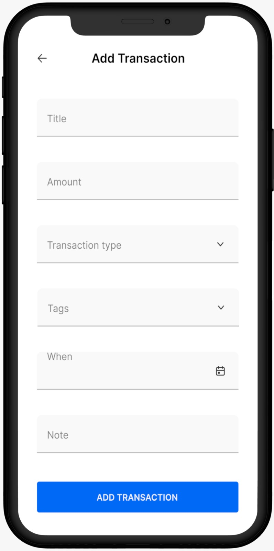
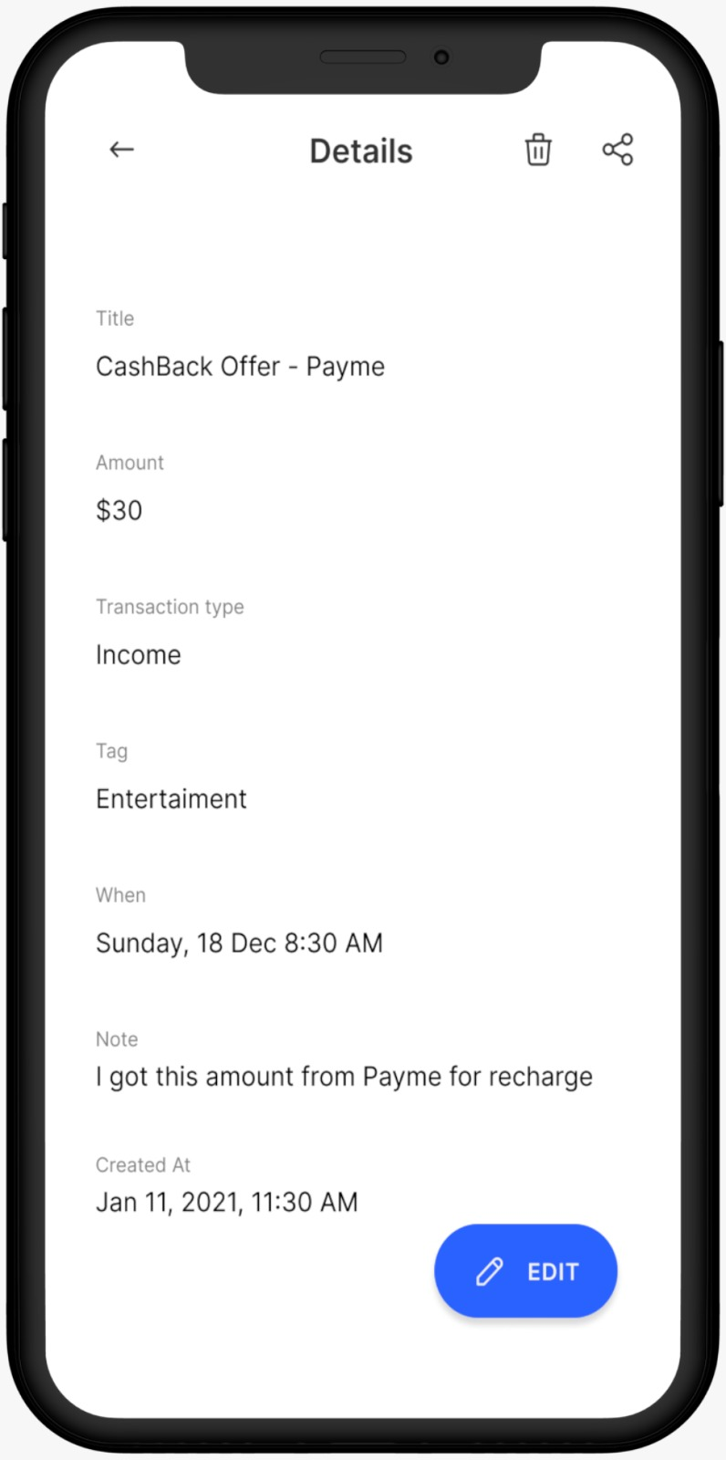
OUTPUT:

Slide 30
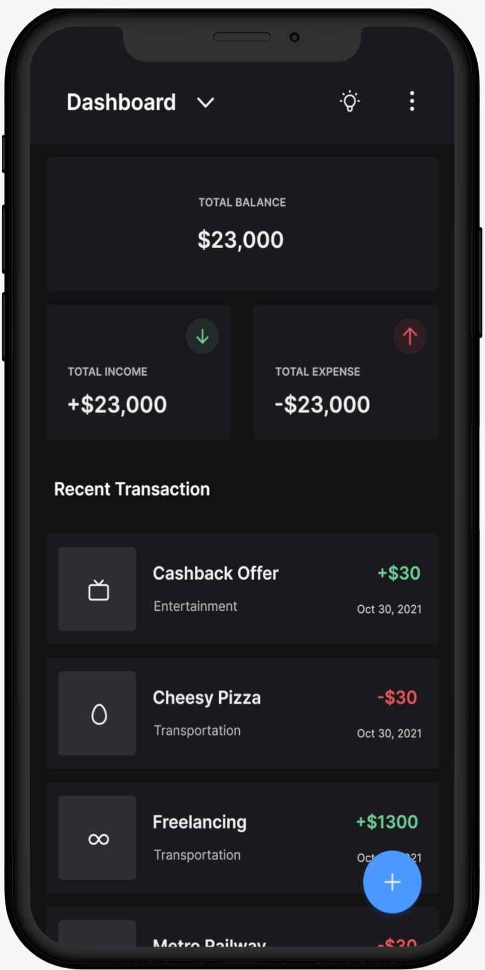
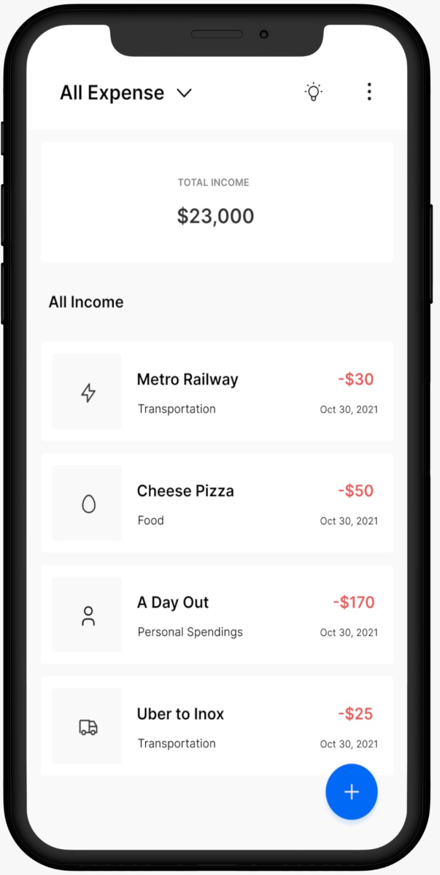

Slide 31
